Slide 1

Copy Test
DViO DIGITAL
By: Amatulla Bagasrawala

Slide 2
QUESTION 01

Slide 3


CHOSEN CAMPAIGN
SCHOOLGIRL
NEWSCASTERS

Slide 4
why?
REASON: IT SEEMS LIKE AN ACT OF PUBLIC SHAMING.

Slide 5
PROBLEM
Using public displays of their struggles, such as having them read as news anchors despite their difficulties, might inadvertently impact their confidence and self-esteem. Some girls might be mentally affected due to the act of public shaming.
SOLUTION
INSTEAD OF SHOWING THE WORLD THAT THEY NEED HELP, INSPIRE THEM!

Slide 6

HOw TO INSPIRE?
STARTING A PLATFORM AND SHOWCASING THE STORIES OF THE WOMEN WHO THEY MIGHT RELATE TO.
An Instagram page where women of the world will share their stories..

Slide 7

CAMPAIGN NAME:
#BurkhaWithBrains

Slide 8

CREATIVE:
In some families, boys get everything they need to study, even if they don’t really care about school, while girls who love learning are told they can’t. Imagine a girl watching her brother ignore his books, even though she wishes she could use them. She might sneak them at night, trying to teach herself because no one supports her dream to learn. Maybe her brother helps her later, but she still wonders why her family and the world don’t believe in her the same way they believe in him. She wishes the world is same for her as well.
-Saima Ameen
Chartered Accountant in DHU Bank
Reference

Slide 9
QUESTION 02

Slide 10

IT’S TIME GET CELEBRITIES OUT OF BUSINESS!

Slide 11

PRESENTING..
#Dine'n'Shine!

Slide 12


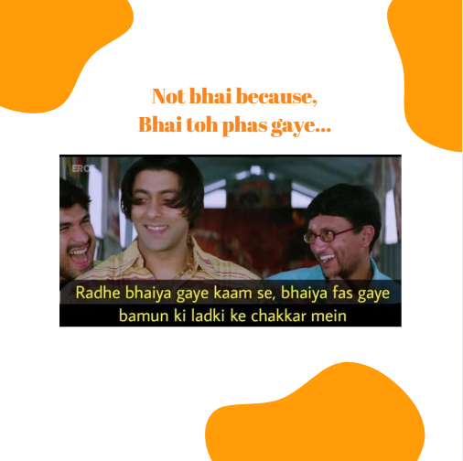

POST 1:
PC: Who will become Swiggy’s next brand ambassador and why it’s YOU!
#Dine'n'Shine!

Slide 13
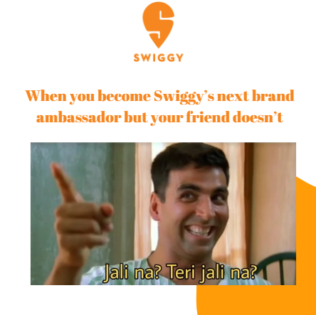
POST 2:
PC: Tag your ‘FOMO’ fam!!
#Dine'n'Shine!

Slide 14
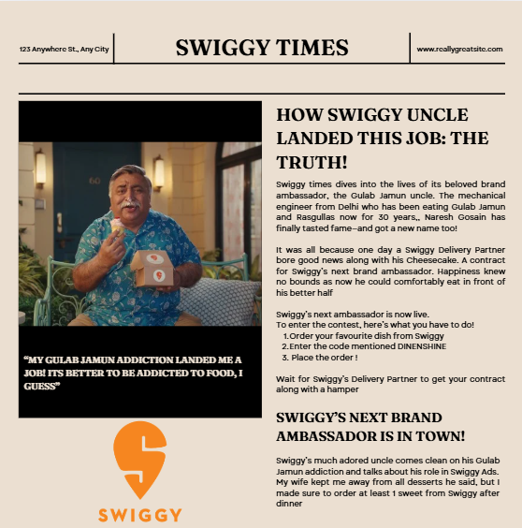
POST 3:
PC: Put your foodie passion to work—join Swiggy as the next big dill!
#Dine'n'Shine!

Slide 15
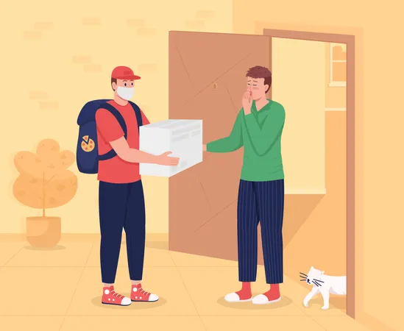

POST 3:
Your order, sir
And my modeling contract?
PC: Each meal can close you a deal !
#Dine'n'Shine!

Slide 16
QUESTION 03

Slide 17

PAGE 1
PROBLEM
Picture this: You’re on LinkedIn, scrolling through opportunities, and BAM! A shiny job offer lands in your inbox. Excited, you apply. But instead of an interview, you get… scammed!
“Buy this course,” she says—a special course that promises to ‘guarantee your success.’ You politely decline, thinking that’ll be the end of it. But nope, she doesn’t give up.
She keeps trying, again and again. Frustrated, you start asking her pointed questions, hoping to expose the scam and make her stop. But instead, she doubles down, becoming even more persistent.
And that’s when it hits you—you weren’t being recruited. You were being targeted.
(this is exactly what happened to me!)

Slide 18

SOLUTION?
AWARENESS!

Slide 19

CAMPAIGN NAME:
LinkOut of Scams

Slide 20
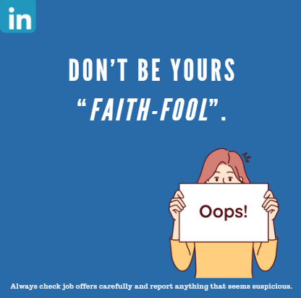
POST 1:
CONCEPT: reminder using a wordplay on the most common phrase in job emails.
VISUAL: copy centric static post.
COPY:
Headline: Don’t be Yours Faith-Fool.
Subtext: Always check job offers carefully and report anything that seems suspicious.

Slide 21
POST 2:
CONCEPT: Urging people not to trust every hiring message and to stay cautious.
VISUAL: It will be a carousel post of 3 slides.
COPY:
Frame 1: Job Scams are taking over LINKEDIN!
Frame 2: Don’t ignore these red flags:
‘Buy this course’ promises.
Pressure tactics to act fast.
Unrealistic guarantees.
Frame 3: Formally speaking ‘DON’T BE STUPID!’

Slide 22
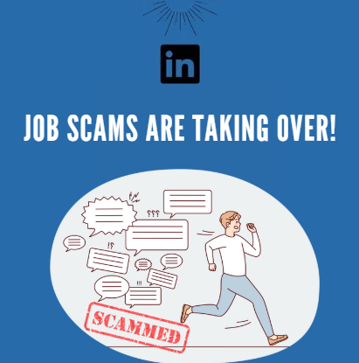



Slide 23
SUGGESTION:
I've noticed that there are a lot of fake job postings on LinkedIn, and they’re scamming people and making the platform less trustworthy. My idea is to add a feature where users can report companies or job postings they think are scams. These reports would go into a shared list so other users can check and avoid those scams. This way, people can help each other stay safe while making LinkedIn a better and more reliable place for everyone.

Slide 24


